Slide 1
Operating Systems Concepts
Concurrency: Mutual Exclusion and Synchronization
Mirela Gutica
BCIT
Based on: Eighth Edition By William Stallings

Slide 2
Multiple Processes
Operating System design is concerned with the management of processes and threads:
Multiprogramming
Multiprocessing
Distributed Processing
Notes:
The central themes of operating system design are all concerned with the management of processes and threads:
• Multiprogramming: The management of multiple processes within a uniprocessor system
• Multiprocessing : The management of multiple processes within a multiprocessor
• Distributed processing: The management of multiple processes executing on multiple, distributed computer systems. The recent proliferation of clusters is a prime example of this type of system.

Slide 3
Concurrency Arises in Three Different Contexts:
Multiple Applications
invented to allow processing time to be shared among active applications
Structured Applications
extension of modular design and structured programming
Operating System Structure
OS themselves implemented as a set of processes or threads
Notes:
Fundamental to all of these areas, and fundamental to OS design, is concurrency. Concurrency encompasses a host of design issues, including communication among processes, sharing of and competing for resources (such as memory, files, and I/O access), synchronization of the activities of multiple processes, and allocation of processor time to processes. We shall see that these issues arise not just in multiprocessing and distributed processing environments but even in single-processor multiprogramming systems.
Concurrency arises in three different contexts:
• Multiple applications: Multiprogramming was invented to allow processing time to be dynamically shared among a number of active applications.
• Structured applications: As an extension of the principles of modular design and structured programming, some applications can be effectively programmed as a set of concurrent processes.
Operating system structure: The same structuring advantages apply to systems programs, and we have seen that operating systems are themselves often implemented as a set of processes or threads.

Slide 4

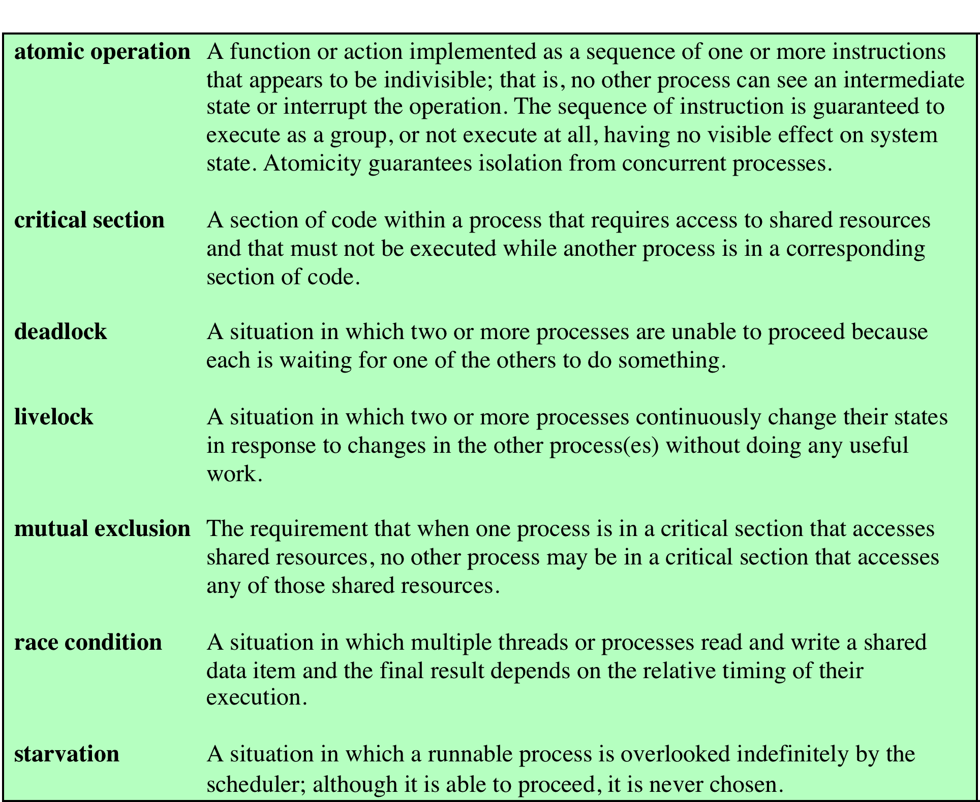
Table 5.1
Some Key Terms Related
to Concurrency
Notes:
Table 5.1 lists some key terms
related to concurrency. A set of animations that illustrate concepts in this chapter is
available online. Click on the rotating globe at this book’s Web site at WilliamStallings.
com/OS/OS7e.html for access.

Slide 5
Concurrency (1)
Communication among processes
Sharing resources
Synchronization of multiple processes or threads
Allocation of processor time

Slide 6
Concurrency(2)
Uniprocessor Machine
The processes are interleaved
Multiprocessor Machine
The processes are overlapped
Are the issues of concurrency different?
In both cases, there are similar problems related to concurrency.

Slide 7
Principles of Concurrency
Interleaving and overlapping
can be viewed as examples of concurrent processing
both present the same problems
Uniprocessor – the relative speed of execution of processes cannot be predicted
depends on activities of other processes
the way the OS handles interrupts
scheduling policies of the OS
Notes:
At first glance, it may seem that interleaving and overlapping represent fundamentally different modes of execution and present different problems. In fact, both techniques can be viewed as examples of concurrent processing, and both present the same problems. In the case of a uniprocessor, the problems stem from a basic characteristic of multiprogramming systems: The relative speed of execution of processes cannot be predicted. It depends on the activities of other processes, the way in which the OS handles interrupts, and the scheduling policies of the OS.

Slide 8
Difficulties of Concurrency
Sharing of global resources
Difficult for the OS to manage the allocation of resources optimally
Difficult to locate programming errors as results are not deterministic and reproducible
Notes:
The following difficulties arise:
1. The sharing of global resources is fraught with peril. For example, if two processes both make use of the same global variable and both perform reads and writes on that variable, then the order in which the various reads and writes are executed is critical. An example of this problem is shown in the following subsection.
2. It is difficult for the OS to manage the allocation of resources optimally. For example, process A may request use of, and be granted control of, a particular I/O channel and then be suspended before using that channel. It may be undesirable for the OS simply to lock the channel and prevent its use by other processes; indeed this may lead to a deadlock condition, as described in Chapter 6 .
3. It becomes very difficult to locate a programming error because results are typically not deterministic and reproducible (e.g., see [LEBL87, CARR89, SHEN02] for a discussion of this point).
All of the foregoing difficulties present themselves in a multiprocessor system as well, because here too the relative speed of execution of processes is unpredictable. A multiprocessor system must also deal with problems arising from the simultaneous execution of multiple processes. Fundamentally, however, the problems are the same as those for uniprocessor systems. This should become clear as the discussion proceeds.

Slide 9
Operating System Concerns
Keep track of active processes
Allocate and de-allocate resources
Processor time
Memory
Files
I/O devices
Protect data and resources
Result of process must be independent of the speed of execution of other concurrent processes – VERY IMPORTANT
Notes:
What design and management issues are raised by the existence of concurrency?
We can list the following concerns:
1. The OS must be able to keep track of the various processes. This is done with the use of process control blocks and was described in Chapter 4 .
2. The OS must allocate and de-allocate various resources for each active process.
At times, multiple processes want access to the same resource. These resources include
• Processor time: This is the scheduling function, discussed in Part Four.
• Memory: Most operating systems use a virtual memory scheme. The topic is addressed in Part Three.
• Files: Discussed in Chapter 12 .
• I/O devices: Discussed in Chapter 11 .
3. The OS must protect the data and physical resources of each process against
unintended interference by other processes. This involves techniques that relate to memory, files, and I/O devices. A general treatment of protection is found in Part Seven .
4. The functioning of a process, and the output it produces, must be independent
of the speed at which its execution is carried out relative to the speed of other
concurrent processes. This is the subject of this chapter.

Slide 10
Table 5.2
Process Interaction
Notes:
We can classify the ways in which processes interact on the basis of the degree to which they are aware of each other’s existence. Table 5.2 lists three possible degrees of awareness plus the consequences of each:
• Processes unaware of each other: These are independent processes that are not
intended to work together. The best example of this situation is the multiprogramming of multiple independent processes. These can either be batch jobs or interactive sessions or a mixture. Although the processes are not working together, the OS needs to be concerned about competition for resources. For example, two independent applications may both want to access the same disk or file or printer. The OS must regulate these accesses.
• Processes indirectly aware of each other: These are processes that are not necessarily
aware of each other by their respective process IDs but that share access to some object, such as an I/O buffer. Such processes exhibit cooperation in sharing the common object.
• Processes directly aware of each other: These are processes that are able to
communicate with each other by process ID and that are designed to work jointly on some activity. Again, such processes exhibit cooperation .
Conditions will not always be as clear-cut as suggested in Table 5.2 . Rather, several processes may exhibit aspects of both competition and cooperation. Nevertheless, it is productive to examine each of the three items in the preceding list separately and determine their implications for the OS.

Slide 11
Resource Competition
Concurrent processes come into conflict when they are competing for use of the same resource
for example: I/O devices, memory, processor time, clock
In the case of competing processes three control problems must be faced:
the need for mutual exclusion
side-effect: deadlock
side-effect: starvation
Notes:
Concurrent processes come into conflict with each other when they are competing for the use of the same resource. In its pure form, we can describe the situation as follows. Two or more processes need to access a resource during the course of their execution. Each process is unaware of the existence of other processes, and each is to be unaffected by the execution of the other processes. It follows from this that each process should leave the state of any resource that it uses unaffected. Examples of resources include I/O devices, memory, processor time, and the clock.
There is no exchange of information between the competing processes. However, the execution of one process may affect the behavior of competing processes. In particular, if two processes both wish access to a single resource, then one process will be allocated that resource by the OS, and the other will have to wait. Therefore, the process that is denied access will be slowed down. In an extreme case, the blocked process may never get access to the resource and hence will never terminate successfully.
In the case of competing processes three control problems must be faced. First is the need for mutual exclusion . Suppose two or more processes require access to a single non-sharable resource, such as a printer. During the course of execution, each process will be sending commands to the I/O device, receiving status information, sending data, and/or receiving data. We will refer to such a resource as a critical resource , and the portion of the program that uses it as a critical section of the program. It is important that only one program at a time be allowed in its critical section. We cannot simply rely on the OS to understand and enforce this restriction because the detailed requirements may not be obvious. In the case of the printer, for example, we want any individual process to have control of the printer while it prints an entire file. Otherwise, lines from competing processes will be interleaved.
The enforcement of mutual exclusion creates two additional control problems. One is that of deadlock . For example, consider two processes, P1 and P2, and two resources, R1 and R2. Suppose that each process needs access to both resources to perform part of its function. Then it is possible to have the following situation: the OS assigns R1 to P2, and R2 to P1. Each process is waiting for one of the two resources. Neither will release the resource that it already owns until it has acquired the other resource and performed the function requiring both resources. The two processes are deadlocked.
A final control problem is starvation . Suppose that three processes (P1, P2, P3) each require periodic access to resource R. Consider the situation in which P1 is in possession of the resource, and both P2 and P3 are delayed, waiting for that resource. When P1 exits its critical section, either P2 or P3 should be allowed access to R. Assume that the OS grants access to P3 and that P1 again requires access before P3 completes its critical section. If the OS grants access to P1 after P3 has finished, and subsequently alternately grants access to P1 and P3, then P2 may indefinitely be denied access to the resource, even though there is no deadlock situation.

Slide 12
A Simple Example
void echo()
{
chin = getchar();
chout = chin;
putchar(chout);
}

Slide 13
A Simple Example
Process P1 Process P2
. .
in = getchar(); .
. in = getchar();
chout = chin; chout = chin;
putchar(chout); .
. putchar(chout);
. .

Slide 14
Mutual Exclusion
Mutual Exclusion
Mechanism for avoiding race condition by preventing two processes from running in their critical section
Critical Section
Section of code in a program that accesses a set of shared variables or resources
Race Condition
When the order of process completion does make a difference, the problem is called race condition

Slide 15
Critical Section
We should only exclude the processes to run in parallel when they are in their critical section.
How can we prevent processes from running in their critical section at the same time (i.e. two editors writing the same text field)?
Answer:We should design a mechanism for passing messages.

Slide 16
Race Condition (1)
A race condition is a situation where two processes either communicate or share memory while they are running and the output of one or both processes depends on the relative speed of the two processes.
A race condition occurs when the two processes are running in parallel.
We need an additional mechanism that prevents some processes from running in parallel when two or more of them are using shared memory.

Slide 17
Race Condition (2)
Race conditions are consider to be bad because computers should be deterministic.
In the case of a race condition, in many cases the output is wrong.

Slide 18
Competition Among Processes for Resources
Mutual Exclusion
Critical sections
Only one program at a time is allowed in its critical section
Example only one process at a time is allowed to send command to the printer
Deadlock
Starvation

Slide 19
Cooperation Among Processes by Sharing
Writing must be mutually exclusive
Reading shouldn’t be mutually exclusive
Critical sections are used to provide data integrity
Deadlock and starvation may occur

Slide 20
Cooperation Among Processes by Communication
Messages are passes
Mutual exclusion is not a control requirement (there are other methods)
Possible to have deadlock
Each process waiting for a message from the other process
Possible to have starvation
Two processes sending message to each other while another process waits for a message

Slide 21
Requirements for Mutual Exclusion
Must be enforced
A process that halts must do so without interfering with other processes
No deadlock or starvation
A process must not be denied access to a critical section when there is no other process using it
No assumptions are made about relative process speeds or number of processes
A process remains inside its critical section for a finite time only
Notes:
Any facility or capability that is to provide support for mutual exclusion should
meet the following requirements:
1. Mutual exclusion must be enforced: Only one process at a time is allowed into
its critical section, among all processes that have critical sections for the same resource or shared object.
2. A process that halts in its noncritical section must do so without interfering
with other processes.
3. It must not be possible for a process requiring access to a critical section to be
delayed indefinitely: no deadlock or starvation.
4. When no process is in a critical section, any process that requests entry to its
critical section must be permitted to enter without delay.
5. No assumptions are made about relative process speeds or number of processors.
6. A process remains inside its critical section for a finite time only.
There are a number of ways in which the requirements for mutual exclusion can be satisfied. One approach is to leave the responsibility with the processes that wish to execute concurrently. Processes, whether they are system programs or application programs, would be required to coordinate with one another to enforce mutual exclusion, with no support from the programming language or the OS. We can refer to these as software approaches. Although this approach is prone to high processing overhead and bugs, it is nevertheless useful to examine such approaches to gain a better understanding of the complexity of concurrent processing. This topic is covered in Appendix A . A second approach involves the use of special purpose machine instructions. These have the advantage of reducing overhead but nevertheless will be shown to be unattractive as a general-purpose solution; they are covered in Section 5.2 . A third approach is to provide some level of support within the OS or a programming language. Three of the most important such approaches are examined in Sections 5.3 through 5.5 .

Slide 22
Requirements for Mutual Exclusion (2)
There are two ways in which the requirements for mutual exclusion can be satisfied:
Hardware approach using special-purpose machine instructions
Software approach

Slide 23
Mutual Exclusion: Hardware Support
Interrupt Disabling
uniprocessor system
disabling interrupts
guarantees mutual
exclusion
Disadvantages:
the efficiency of
execution could be
noticeably degraded
this approach will not
work in a
multiprocessor
architecture
Notes:
In a uniprocessor system, concurrent processes cannot have overlapped execution;
they can only be interleaved. Furthermore, a process will continue to run until it
invokes an OS service or until it is interrupted. Therefore, to guarantee mutual exclusion,
it is sufficient to prevent a process from being interrupted. This capability
can be provided in the form of primitives defined by the OS kernel for disabling and
enabling interrupts.
Because the critical section cannot be interrupted, mutual exclusion is guaranteed.
The price of this approach, however, is high. The efficiency of execution could
be noticeably degraded because the processor is limited in its ability to interleave
processes. Another problem is that this approach will not work in a multiprocessor
architecture. When the computer includes more than one processor, it is possible (and
typical) for more than one process to be executing at a time. In this case, disabled
interrupts do not guarantee mutual exclusion.

Slide 24
Mutual Exclusion: Hardware Support
Compare&Swap Instruction
also called a “compare and exchange instruction”
a compare is made between a memory value and a test value
if the values are the same a swap occurs
carried out atomically
Notes:
This version of the instruction checks a memory location ( *word ) against a test value ( testval ). If the memory location’s current value is testval, it is replaced with newval ; otherwise it is left unchanged. The old memory value is always returned; thus, the memory location has been updated if the returned value is the same as the test value. This atomic instruction therefore has two parts: A compare is made between a memory value and a test value; if the values are the same, a swap occurs. The entire compare&swap function is carried out atomically—that is, it is not subject to interruption.
Another version of this instruction returns a Boolean value: true if the swap occurred; false otherwise. Some version of this instruction is available on nearly all processor families (x86, IA64, sparc, IBM z series, etc.), and most operating systems use this instruction for support of concurrency.

Slide 25
Figure 5.2
Hardware Support for Mutual Exclusion
(a) Compare and swap instruction (b) Exchange instruction
Notes:
Figure 5.2a shows a mutual exclusion protocol based on the use of this instruction. A shared variable bolt is initialized to 0. The only process that may enter its critical section is one that finds bolt equal to 0. All other processes attempting to enter their critical section go into a busy waiting mode. The term busy waiting , or spin waiting , refers to a technique in which a process can do nothing until it gets permission to enter its critical section but continues to execute an instruction or set of instructions that tests the appropriate variable to gain entrance. When a process leaves its critical section, it resets bolt to 0; at this point one and only one of the waiting processes is granted access to its critical section. The choice of process depends on which process happens to execute the compare & swap instruction next.
Figure 5.2b shows a mutual exclusion protocol based on the use of an exchange instruction. A shared variable bolt is initialized to 0. Each process uses a local variable key that is initialized to 1. The only process that may enter its critical section is one that finds bolt equal to 0. It excludes all other processes from the critical section by setting bolt to 1. When a process leaves its critical section, it resets bolt to 0, allowing another process to gain access to its critical section.

Slide 26
Mutual Exclusion: Hardware Support
Test and Set Instruction
boolean testset (int i) {
if (i == 0) {
i = 1;
return true;
}
else {
return false;
}
}

Slide 27
Mutual Exclusion: Hardware Support
Exchange Instruction
void exchange(int register, int memory)
{
int temp;
temp = memory;
memory = register;
register = temp;
}

Slide 28
Special Machine Instruction: Advantages
Applicable to any number of processes on either a single processor or multiple processors sharing main memory
Simple and easy to verify
It can be used to support multiple critical sections; each critical section can be defined by its own variable
Notes:
The use of a special machine instruction to enforce mutual exclusion has a number of advantages:
• It is applicable to any number of processes on either a single processor or multiple processors sharing main memory.
• It is simple and therefore easy to verify.
• It can be used to support multiple critical sections; each critical section can be defined by its own variable.

Slide 29
Special Machine Instruction: Disadvantages
Busy-waiting is employed, thus while a process is waiting for access to a critical section it continues to consume processor time
Starvation is possible when a process leaves a critical section and more than one process is waiting
Deadlock is possible
Notes:
There are some serious disadvantages:
• Busy waiting is employed: Thus, while a process is waiting for access to a critical section, it continues to consume processor time.
Starvation is possible: When a process leaves a critical section and more than one process is waiting, the selection of a waiting process is arbitrary. Thus, some process could indefinitely be denied access.
•
Deadlock is possible: Consider the following scenario on a single-processor system. Process P1 executes the special instruction (e.g., compare & swap, exchange ) and enters its critical section. P1 is then interrupted to give the processor to P2, which has higher priority. If P2 now attempts to use the same resource as P1, it will be denied access because of the mutual exclusion mechanism. Thus, it will go into a busy waiting loop. However, P1 will never be dispatched because it is of lower priority than another ready process, P2.
Because of the drawbacks of both the software and hardware solutions just outlined, we need to look for other mechanisms.

Slide 30
Synchronization & Communication
When processes interact with one another two requirements should be satisfied:
Synchronization
Communication

Slide 31
Table 5.3
Common
Concurrency
Mechanisms
Notes:
We now turn to OS and programming language mechanisms that are used to provide concurrency. Table 5.3 summarizes mechanisms in common use. We begin, in this section, with semaphores. The next two sections discuss monitors and message passing. The other mechanisms in Table 5.3 are discussed when treating specific operating system examples, in Chapters 6 and 13 .

Slide 32
Semaphore
An OS primitive variable that has an integer value upon which only three operations are defined:
There is no way to inspect or manipulate semaphores other than these three operations
Init () May be initialized to a nonnegative integer value
Wait() This operation decrements the value
Signal() This operation increments the value
Notes:
The fundamental principle is this: Two or more processes can cooperate by means of simple signals, such that a process can be forced to stop at a specified place until it has received a specific signal. Any complex coordination requirement can be satisfied by the appropriate structure of signals. For signaling, special variables called semaphores are used. To transmit a signal via semaphore s , a process executes the primitive semSignal(s) . To receive a signal via semaphore s , a process executes the primitive semWait(s) ; if the corresponding signal has not yet been transmitted, the process is suspended until the transmission takes place.
To achieve the desired effect, we can view the semaphore as a variable that has an integer value upon which only three operations are defined:
1. A semaphore may be initialized to a nonnegative integer value.
2. The semWait operation decrements the semaphore value. If the value becomes negative, then the process executing the semWait is blocked.
Otherwise, the process continues execution.
3. The semSignal operation increments the semaphore value. If the resulting value is less than or equal to zero, then a process blocked by a semWait operation, if any, is unblocked. Other than these three operations, there is no way to inspect or manipulate semaphores.
We explain these operations as follows. To begin, the semaphore has a zero or positive value. If the value is positive, that value equals the number of processes that can issue a wait and immediately continue to execute. If the value is zero, either by initialization or because a number of processes equal to the initial semaphore value have issued a wait, the next process to issue a wait is blocked, and the semaphore value goes negative. Each subsequent wait drives the semaphore value further into minus territory. The negative value equals the number of processes waiting to be unblocked. Each signal unblocks one of the waiting processes when the semaphore value is negative.

Slide 33
Semaphores
Special OS primitive variable called a semaphore is used for synchronization
If a process is waiting for a signal, it is suspended until that signal is sent
Wait and signal operations cannot be interrupted (they are atomic actions)
A queue is used to hold processes waiting on the semaphore
A restricted version of a semaphore is a binary semaphore

Slide 34
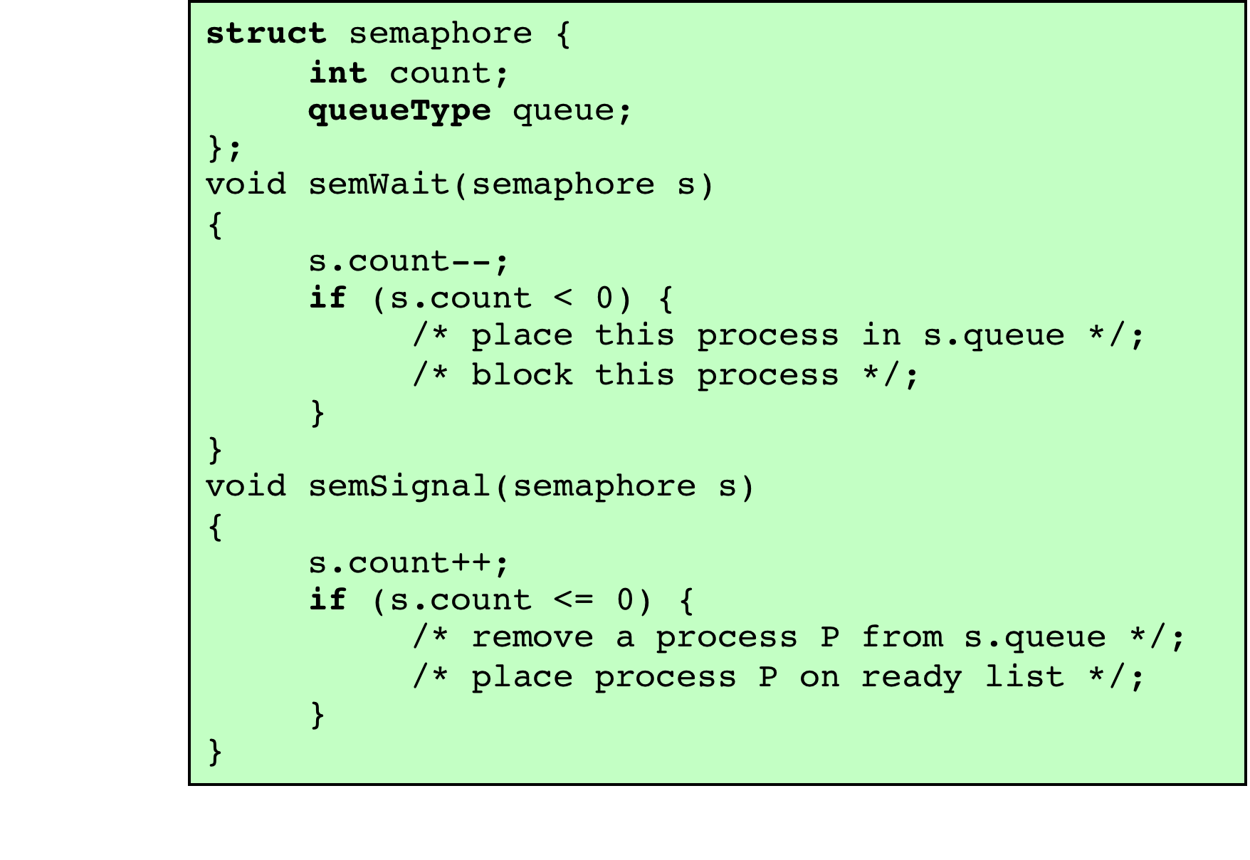
Figure 5.3
A
Definition
of Semaphore Primitives
Notes:
Figure 5.3 suggests a more formal definition of the primitives for semaphores. The semWait and semSignal primitives are assumed to be atomic.

Slide 35
Figure 5.4
A Definition of Binary Semaphore Primitives
Notes:
A more restricted version, known as the binary semaphore , is defined in Figure 5.4 . A binary semaphore may only take on the values 0 and 1 and can be defined by the following three operations:
1. A binary semaphore may be initialized to 0 or 1.
2. The semWaitB operation checks the semaphore value. If the value is zero, then the process executing the semWaitB is blocked. If the value is one, then the value is changed to zero and the process continues execution.
3. The semSignalB operation checks to see if any processes are blocked on this semaphore (semaphore value equals 0). If so, then a process blocked by a semWaitB operation is unblocked. If no processes are blocked, then the value of the semaphore is set to one.
In principle, it should be easier to implement the binary semaphore, and it can be shown that it has the same expressive power as the general semaphore (see Problem 5.16). To contrast the two types of semaphores, the nonbinary semaphore is often referred to as either a counting semaphore or a general semaphore .
A concept related to the binary semaphore is the mutual exclusion lock
(mutex) . A mutex is a programming flag used to grab and release an object. When
data are acquired that cannot be shared or processing is started that cannot be
performed simultaneously elsewhere in the system, the mutex is set to lock (typically
zero), which blocks other attempts to use it. The mutex is set to unlock
when the data are no longer needed or the routine is finished. A key difference
between the a mutex and a binary semaphore is that the process that locks the
mutex (sets the value to zero) must be the one to unlock it (sets the value to 1). In
contrast, it is possible for one process to lock a binary semaphore and for another
to unlock it.

Slide 36
Strong/Weak Semaphores
A queue is used to hold processes waiting on the semaphore
Strong Semaphores
the process that has been blocked the longest is released from the queue first (FIFO)
Weak Semaphores
the order in which processes are removed from the queue is not specified
Notes:
For both counting semaphores and binary semaphores, a queue is used to hold processes waiting on the semaphore. The question arises of the order in which processes are removed from such a queue. The fairest removal policy is first-in-first-out (FIFO): The process that has been blocked the longest is released from the queue first; a semaphore whose definition includes this policy is called a strong semaphore . A semaphore that does not specify the order in which processes are removed from the queue is a weak semaphore .

Slide 37
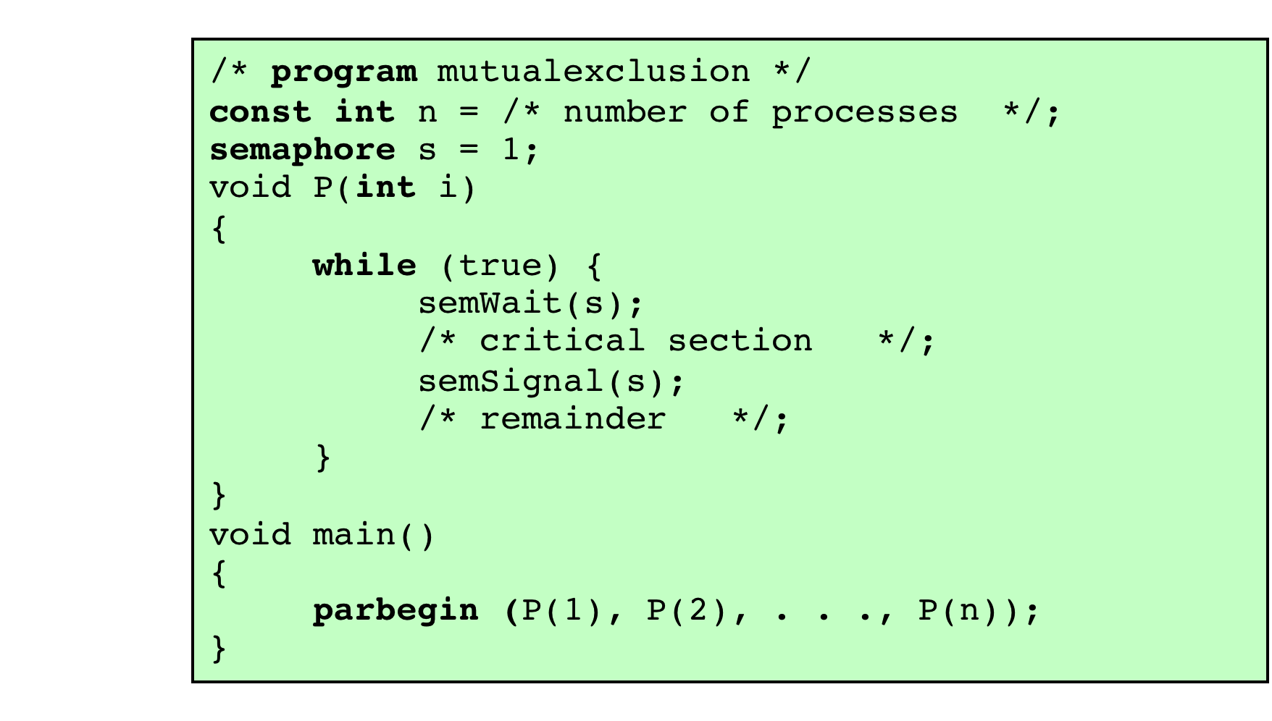
Figure 5.6
Mutual Exclusion Using Semaphores
Notes:
For the mutual exclusion algorithm discussed in the next subsection and illustrated in Figure 5.6 , strong semaphores guarantee freedom from starvation, while weak semaphores do not. We will assume strong semaphores because they are more convenient and because this is the form of semaphore typically provided by operating systems.
Figure 5.6 shows a straightforward solution to the mutual exclusion problem using a semaphore s (compare Figure 5.1 ). Consider n processes, identified in the array P ( i ), all of which need access to the same resource. Each process has a critical section used to access the resource. In each process, a semWait(s) is executed just before its critical section. If the value of s becomes negative, the process is blocked. If the value is 1, then it is decremented to 0 and the process immediately enters its critical section; because s is no longer positive, no other process will be able to enter its critical section.
The semaphore is initialized to 1. Thus, the first process that executes a semWait will be able to enter the critical section immediately, setting the value of s to 0. Any other process attempting to enter the critical section will find it busy and will be blocked, setting the value of s to –1. Any number of processes may attempt entry; each such unsuccessful attempt results in a further decrement of the value of s . When the process that initially entered its critical section departs, s is incremented and one of the blocked processes (if any) is removed from the queue of blocked processes associated with the semaphore and put in a Ready state. When it is next scheduled by the OS, it may enter the critical section.

Slide 38
Notes:
Figure 5.7, based on one in [BACO03], shows a possible sequence for three
processes using the mutual exclusion discipline of Figure 5.6. In this example three
processes (A, B, C) access a shared resource protected by the semaphore lock .
Process A executes semWait (lock) ; because the semaphore has a value of 1 at
the time of the semWait operation, A can immediately enter its critical section and
the semaphore takes on the value 0. While A is in its critical section, both B and
C perform a semWait operation and are blocked pending the availability of the
semaphore. When A exits its critical section and performs semSignal (lock) , B,
which was the first process in the queue, can now enter its critical section.

Slide 39
IPC
IPC stands for Interprocess Communication
There are different styles of communication between processes
Communication should be synchronized with:
Messages
Signals
Pipes (like reading from a file)
Semaphores
Monitors
Several patterns of synchronization

Slide 40
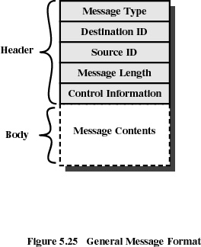
Message Format

Slide 41
Monitors (1)
A monitor is a construct that can be added to any programming language that have defined the concept of abstract data type or object
A monitor is an object designed to be accessed from multiple threads
Many languages have monitors (e.g., Java, C#)
Monitors are implemented in libraries
A monitor has the following components:
Variables (any kind)
Condition variables to signal inside the monitor
Procedures that can be called from outside the monitor

Slide 42
Notes:
Figure 5.15 illustrates the structure of a monitor. Although a process can enter the monitor by invoking any of its procedures, we can think of the monitor as having a single entry point that is guarded so that only one process may be in the monitor at a time. Other processes that attempt to enter the monitor join a queue of processes blocked waiting for monitor availability. Once a process is in the monitor, it may temporarily block itself on condition x by issuing cwait(x) ; it is then placed in a queue of processes waiting to reenter the monitor when the condition changes, and resume execution at the point in its program following the cwait(x) call. If a process that is executing in the monitor detects a change in the condition variable x , it issues csignal(x) , which alerts the corresponding condition queue that the condition has changed.

Slide 43
Monitors (2)
Important characteristics:
Local data variables are accessible only inside the monitor
A thread enters a monitor by invoking one of its procedures
Only one thread may be executing in the monitor at a time
Condition variables are defined only inside the monitor
Condition variables are not the same as semaphore variables; they don’t have memory
cwait(c) – suspends the execution of the calling thread on condition c
csignal(c) – resume execution on the same condition
If a thread signals and no thread is waiting on that condition, then the signal is lost

Slide 44
Semaphores Overview
A semaphore is a low level construct
A semaphore is essentially a shared OS global variable
Can potentially be accessed anywhere in program
A semaphore allows multiple threads or processes(up to a predefined number) to access one or multiple shared objects
No connection exists between the semaphore and the data being controlled by the semaphore
No control or guarantee of proper usage

Slide 45
Monitors Overview
A monitor is a high level construct that encapsulates:
Shared data structures
Procedures that operate on the shared data structures
Synchronization between concurrent procedure invocations
Monitors allow mutually exclusive access to a shared object
A monitor protects its data from unstructured access
Monitors have different implementations (Hoare, Mesa, etc.)

Slide 46
Summary
Principles of concurrency
Race condition
OS concerns
Process interaction
Requirements for mutual exclusion
Mutual exclusion: hardware support
Interrupt disabling
Special machine instructions
Semaphores
Mutual exclusion
Implementation of semaphores
IPC patterns
Monitors
Notes:
Summary of Chapter 5.

